Slide 1
Asana Rebel
Campaign Performance

Slide 2

Introduction
Asana Rebel’s mission is to help everyone achieve a healthy lifestyle by offering the best of health and fitness all in one place.
The app offers hundreds of workouts, as well as sleep assistance, music for focus and meditation.

Slide 3



Objective & Scope
 | Objective | Measure Campaign performance for various campaigns for Asana Rebel
 | Data Source | Installs , Campaigns and Purchases data From 01.11.2020 to 17.02.2021
 | Scope | Android and IOS Australia, Asia, Europe, North America, South and Central America

Slide 4

Various KPI’s

Slide 5
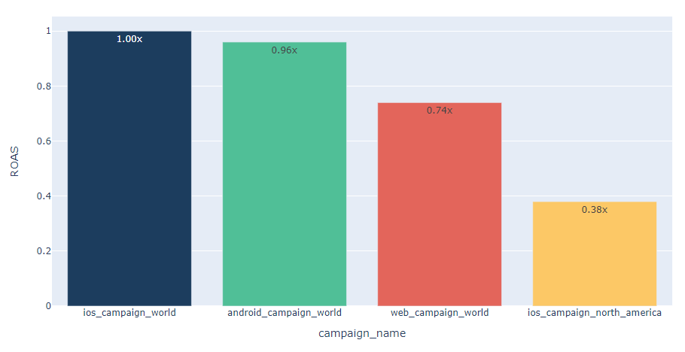
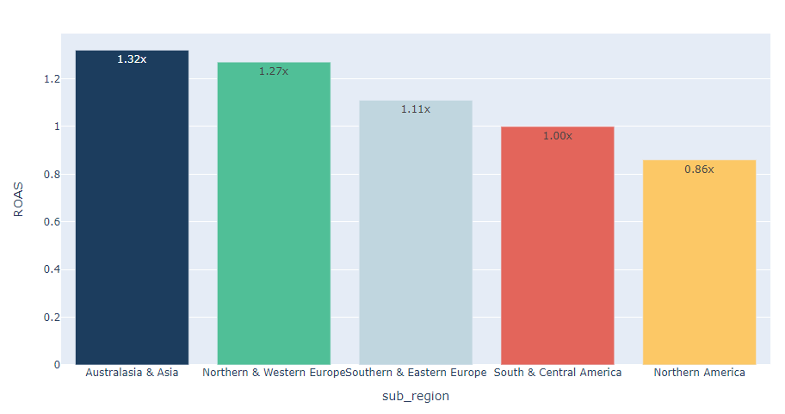
ROAS by campaign and region
Observations & Insights
In order to better understand how the various app and web campaigns are performing, we look at the Return on Ad Spend
We can see that out of the 4 campaigns only the worldwide app campaigns are above the target of 0.9x. We also observe that the North America IOS campaign performs poorly with the least ROAS of 0.38x
We can see that out of the 5 regions, 4 are performing above the target of 0.9 with Australia and Asia performing the best with ROAS of 1.32. We also observe that the Northern America performs the least with ROAS of 0.86

Slide 6
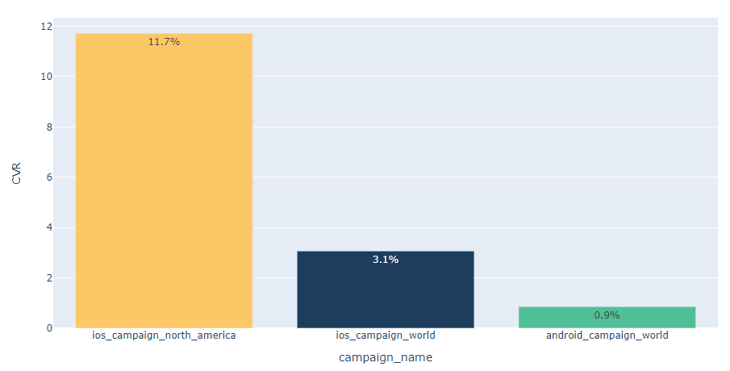
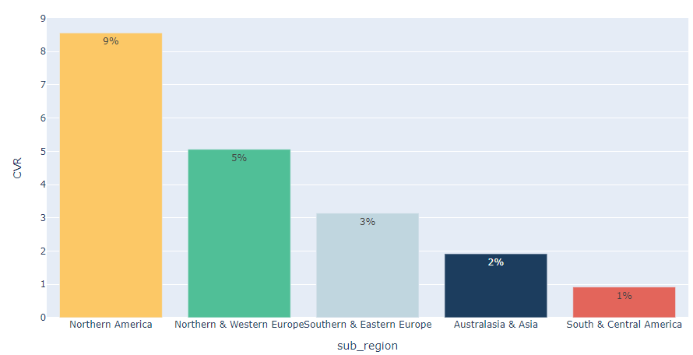
Conversion Rate by campaign and region
Observations & Insights
Understanding how many users did a purchase is essential for any app. To see this, we define Conversion Rate by the # of users who converted out of the # of installers
Looking at the Conversion Rate by campaign we see that North America IOS campaign has the highest Conversion Rate (11.7%) with the Worldwide Android campaign with the least Conversion Rate (0.9%).
We also observe that the Conversion Rate for North America is the highest (9%) with South and Central America with the least (1%) Conversion Rate.

Slide 7
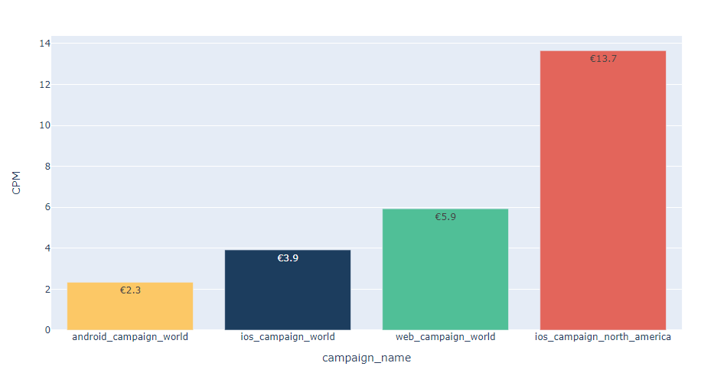
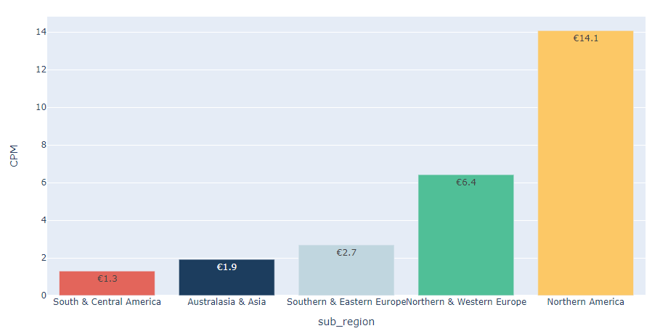
CPM by campaign and region
Observations & Insights
Optimizing the # of impressions shown to users can help significantly reduce costs. To see this, we look at the CPM (Cost per 1000 impressions)
Looking at the CPM by campaign we see that North America IOS campaign has the highest CPM (€13.7) with the Worldwide Android campaign with the least CPM (€2.3).
We also observe that the CPM for North America is the highest (€14.1) with South and Central America with the least (€1.3) CPM.

Slide 8
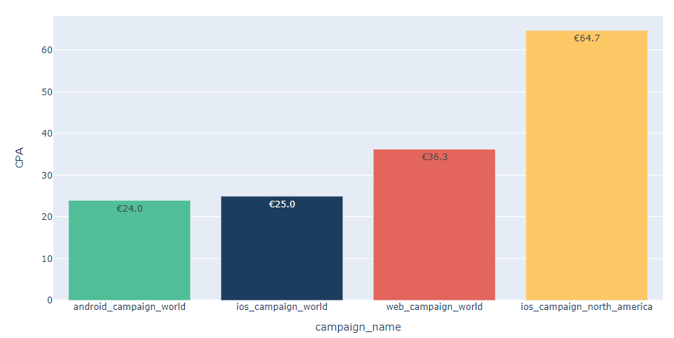
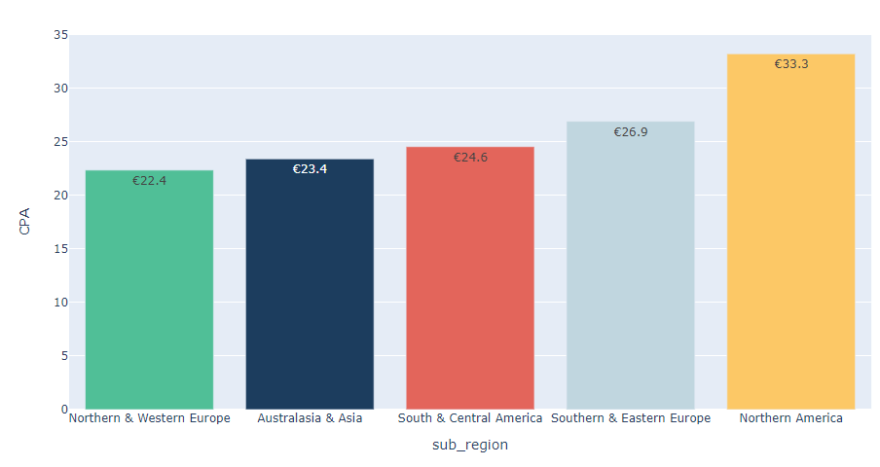
CPA by campaign and region
Observations & Insights
Understanding where we are spending on the campaigns is important to optimize campaign spend. To see this we use CPA (Cost per Action)
Looking at the CPA by campaign we see that North America IOS campaign has the highest CPA (€64.7) with the Worldwide Android campaign with the least CPA (€24).
We also observe that the CPA for North America is the highest (€33.3) with North and Western Europe with the least (€22.4) CPA.

Slide 9
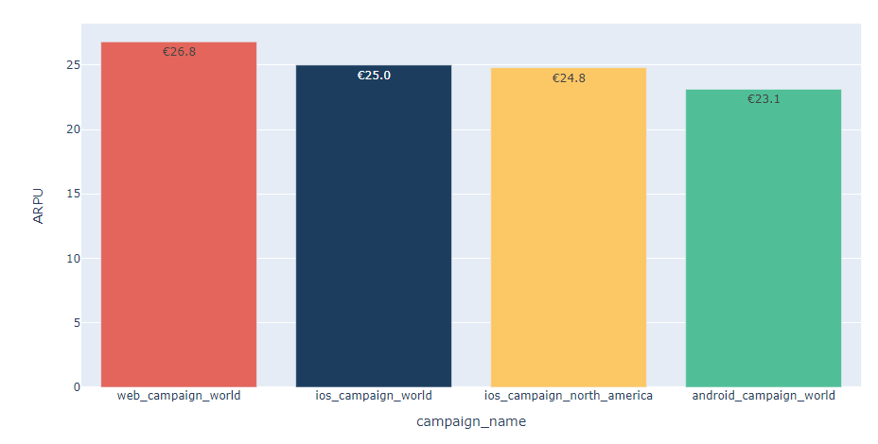
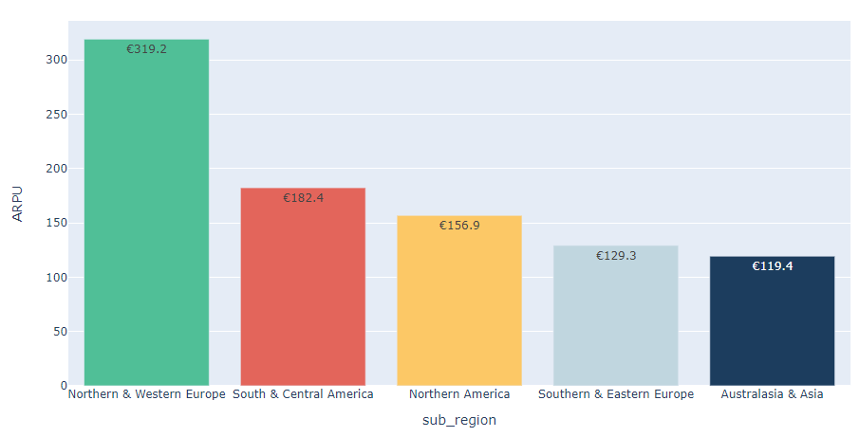
ARPU by campaign and region
Observations & Insights
Understanding how much a user spends within the app is important to in app user behaviour. To see this we use ARPU (Average Revenue Per User)
Looking at the ARPU by campaign we see that Worldwide Web Campaign has the highest ARPU (€26.8) with the Worldwide Android campaign with the least ARPU (€23.1).
We also observe that the ARPU for North and Western Europe is the highest (€319.2) with Australia and Asia with the least (€119.4) ARPU.

Slide 10
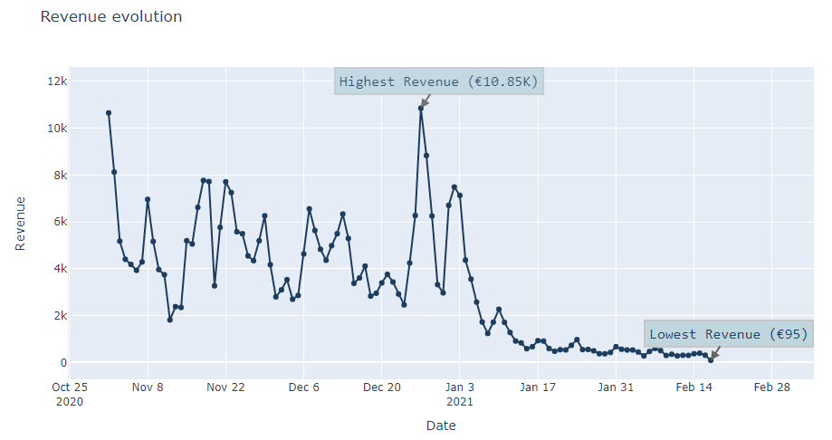
Revenue by days
Observations & Insights
We see the revenue by days to see the evolution of the revenue between the given time period
We can see that the highest revenue is generated on 27th Dec, 2020 and the lowest revenue is recorded on 17th Feb, 2021 which might indicate monthly seasonality.
We observe a significant drop in revenue starting from 1st Jan 2021. This needs to be investigated

Slide 11
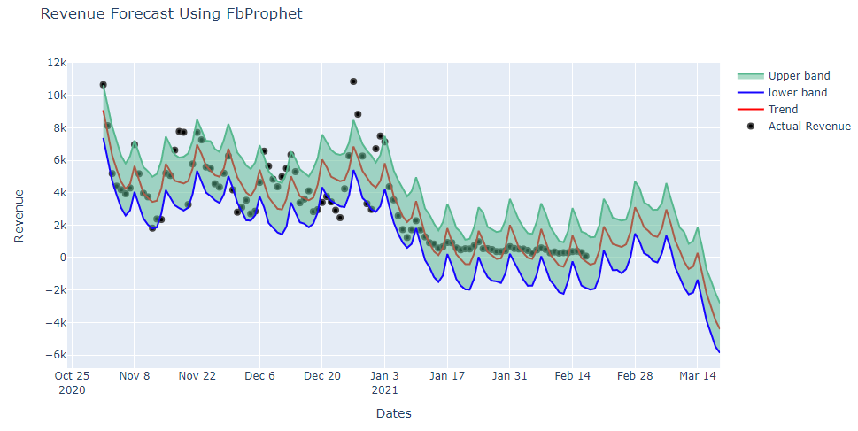
Forecast for 1 month
Observations & Insights
To see the forecast for the next 1 month we first check if the time series is stationary or non stationary.
According to the analysis we see that the time series is non stationary. However, FB prophet takes that into account while forecasting.
According to the forecast we see that the highest revenue is on Feb 28, 2021 with € 3.1K. However, due to seasonality effects the forecast has negative values.

Slide 12

Web Attribution Difficulties

Slide 13
How to deal with web attribution difficulties?
Attribution is one of the most difficult problems we face in digital marketing. There are a lot of models of attribution which are oversimplified and not entirely accurate, we tend to use those because we understand them
According to the analysis, we can deal with the web attribution problem in 2 ways:
Since a web session always happens first before install in case of a web campaign, we compare the values of the install timestamp and the session timestamp.
If the value of session timestamp is less than the install timestamp that means that is a web attribution else it is an app attribution
A web session might happen first before a purchase, we compare the values of the purchase timestamp and the session timestamp
If the value of session timestamp is less than the purchase timestamp that means that is a web attribution else it is an app attribution

Slide 14

Conclusion & Recommendations

Slide 15
Conclusion and Recommendations
The campaigns android_campaign_world and ios_campaign_world have a high performance and the ROAS is above the target of 0.9 and majority of the regions have high ROAS with the best performance observed in Australia and Asia (1.32x). Northern America lags in terms of performance
with ROAS of 0.86x.
in terms of CPM as well the Worldwide App campaigns and Northern and Western Europe having low cost. The Northern America IOS campaign and the region have a high CPM.
The web campaigns have results lower than the target (0.74x) and is inferior compared to app campaigns
We should increase our spending in Australia and Asia and Northern and Western Europe on the Worldwide App campaigns to get even better ROAS.
The performance issues of IOS Northern America campaign should be investigated in detail and the campaign should be tweaked using an AB test.
Targeting regions such as South and Central America should be started since it has high ROAS and lowest CPM
Investigate the missing campaign ids present in the Installers table which leads to Revenue which is unaccounted for.

